Slide 1
Project 4: Geo-tagged File System
Team 19
Bang Jun-ho
Kang Sang-jae
Won Jong-hun

Slide 2
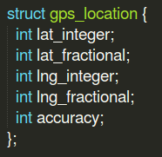

Basic Settings
Added ‘gps_location’ struct in include/linux/gps.h
Implemented ‘sys_set_gps_location’ and ‘sys_get_gps_location’ syscalls to access the location data from user space.
gps_lock: lock for synchronized access to gps location data

Slide 3
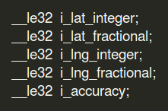
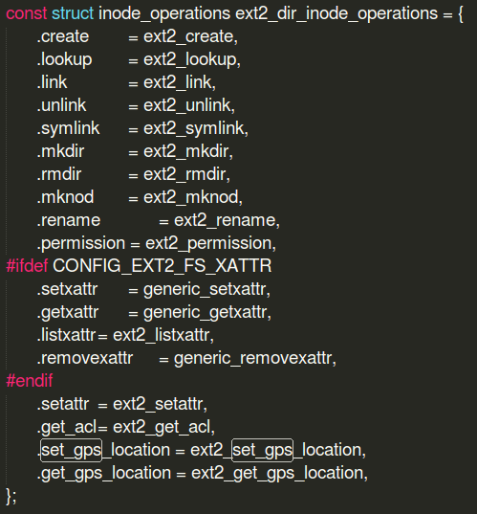
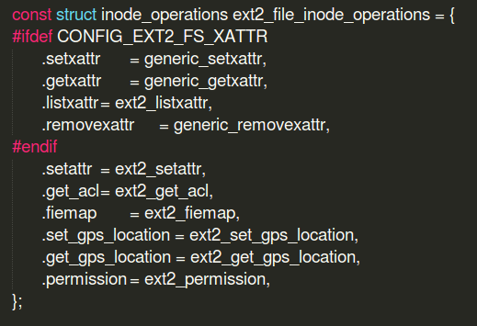
Adding inode fields/operations
Added gps location fields in ext2 inode information
Added following inode operations: ‘ext2_set_gps_location’ ‘ext2_get_gps_location’

Slide 4
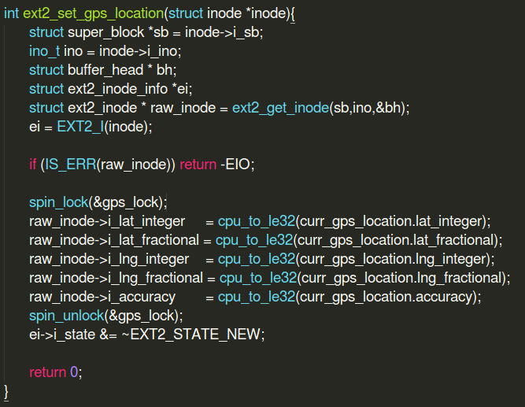
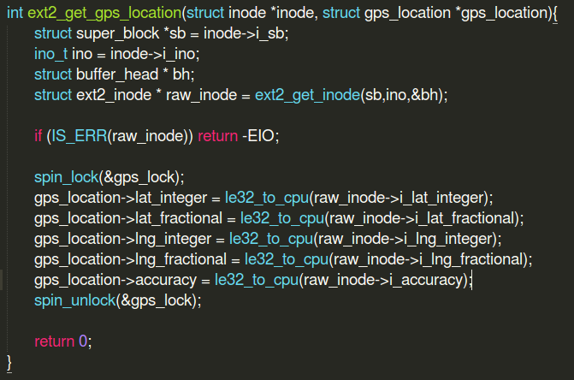
Implementing inode operations
ext2_set_gps_location: sets file location information in inode as the current location of the device
Used cpu_to_le32 to keep endianness
ext2_get_gps_location: extracts the location information in inode
Used le32_to_cpu to keep endianness

Slide 5
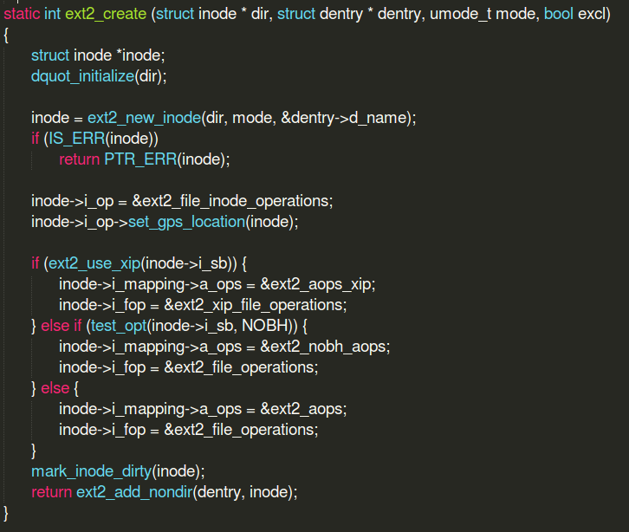
inode operation call
Whenever ext2_create() is called, set_gps_location() is also called so that the location information is stored in inode data structure when a file is created in ext2 file system.
Also modified ext2_mkdir() and ext2_rename(), and ext2_setattr()

Slide 6
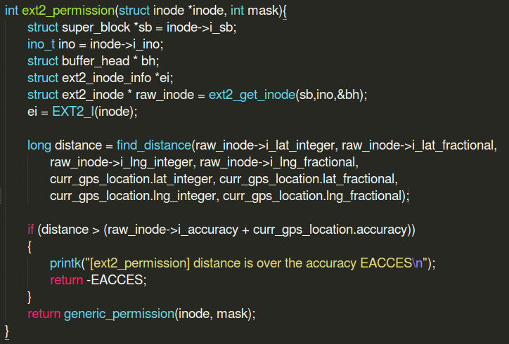
Location-based file access
Every permission problem should go through function do_inode_permission in fs/namei.c.
Originally, there is no function permission in ext2. So ext2 file system just check permission by generic_permission.
So, we implemented ext2_permission to check the location-based file access.

Slide 7
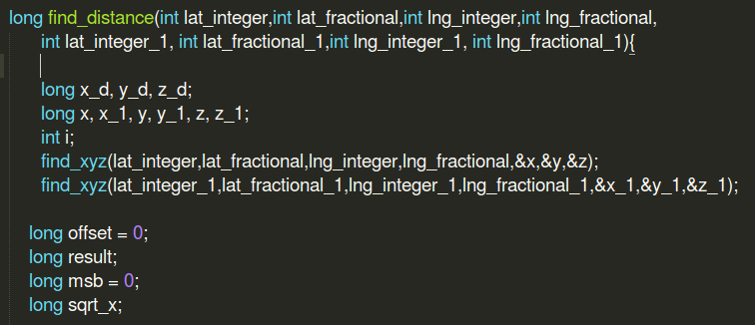
Calculating distance
<Assumptions>
Earth is a sphere with a radius of 6400km.
Cosine and Sine functions can be calculated up to 8th order in the Taylor series.
The distance of two points is a straight line..
Find_distance() calculates the distance between two (latitude, longitude) coordinates

Slide 8
Test Codes

Slide 9
Demo Video
Demo Video

Slide 10
Lessons Learned
Always check Spin lock is unlocked when the function is exited.
For kernel programming, Null pointer error is too critical and hard to debug. We spend a lot of time finding problems that did not return spin lock.
Linux file system is a very high-level hierarchy model.
namei.c , file.c, inode.c ,fs.h and so on, many important function are scattered, so it is really hard to find. The hierarchical structure is complicated, including generic functions and functions implemented in each file system. Since linux file system is made up of multiple file systems in existence, you should treat the hierachy model carefully.
Kernel does not provide a float operation.
cosine, sine, and so on, we need to implement various math function to calculate distance. We cannot use float, so we must implement that calculation only by int operation. It is really tricky.

